Slide 1
IoT-autoconfiguration of new devices in IoT mesh
Night_Dwellers

Slide 2
what are the main tasks of this software?
It scans the mesh network for new devices
When the new device is connected it checks its type and decides how to configure it
Using the already connected and configured devices this software writes the new configurations onto the newly connected device
It allows to use all IoT devices as plug&play devices

Slide 3
Our software also can create or use an existing DataBase of IoT devices connected in the mesh.
Fully scaleable project that can be extended to every type of connection and all types of devices managed remotely

Slide 4
Start with google
For now we have started by adding the basic google smart devices, so they would be compatiable with our software
The software can be fully managed through the commandline or terminal so it can be used on a desktop same as an enterprise grade server

Slide 5
Used in smartHome
Or a smartcar
Or inteligent EDC accessories (smartwatch)
Or cybersecurity additions(firewalls)
Or every day use items(fridge, speakers, tv)

Slide 6
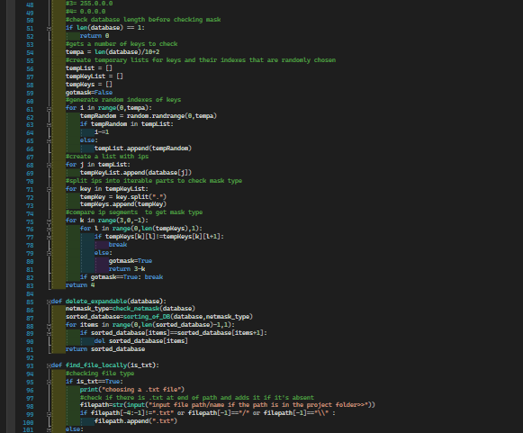
Thank You for Your Time
Night_Dwellers
Jakub Jakub
Gontarz Jodłowski
Nope, we have not slept
We are doing a 10 pushups per hour for 24 hours challange

